Slide 1
PFORCS Ai and ML
Andrew Beatty
Andrew.Beatty@gmit.ie
Programming for cybersecurity

Slide 2
AI and ML artificial intelligence and Machine Learning
Computers are good at following instructions
Humans are good at pattern recognition.
AI meant whatever computers could not do well.
Vision
Complex problem sets
Chess
Machine Learning is taking past data to predict future data

Slide 3
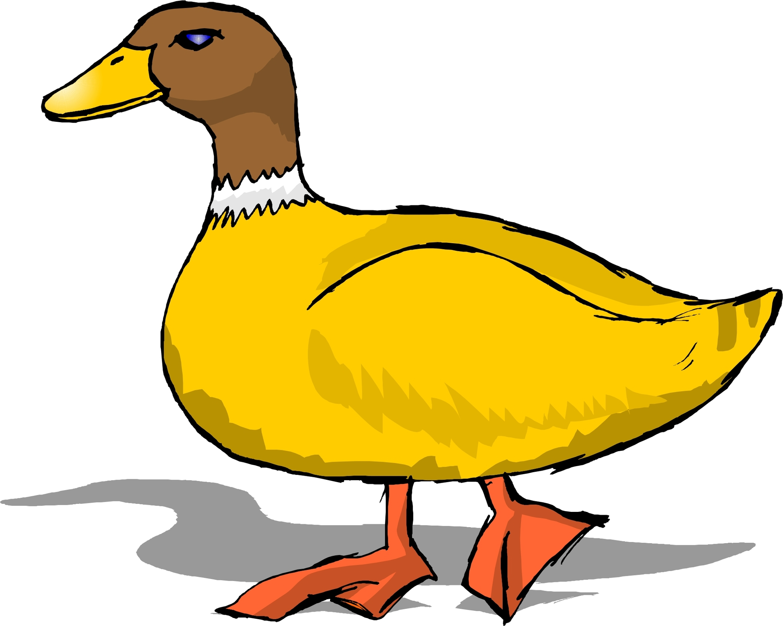

Slide 4


Slide 5
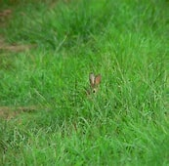

Slide 6
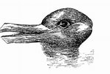

Slide 7
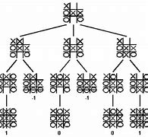
Decision Tree noughts and crosses
What moves can they make after I make my move.

Slide 8
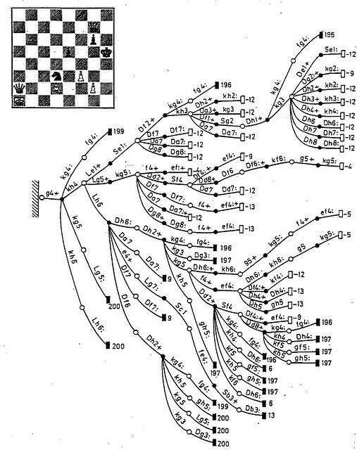
This gets complicated quickly
The number of legal chess positions is 10^40 (10^120 games)
A* algorithm
Heuristics

Slide 9
Machine Learning
All data (the real)
Modern Machine learning is a lot more statistical.
Data you never see
Known data
Training data
Testing data
Data you wish to predict

Slide 10
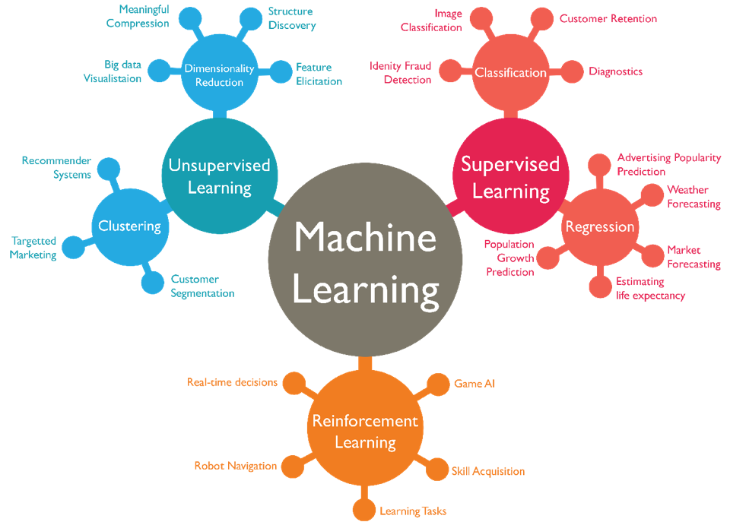
Supervised:
The dataset is labelled,
Some results are given.
Linear Regression,
Logistic Regression,
SVM,
KNN etc
Unsupervised:
The dataset is unlabelled.
Results are not pre known, but information can be extracted from the data.
Discover patterns.
K – Means,
C – Means,
Apriori
Reinforcement:
Reward given for wanted behaviour
Q – Learning,
SARSA

Slide 11
Which library (python)
There are too many, but here are three of the most popular
Scikit-learn:
Open source, built on top of numpy and matplotlib
Simple to use
BSD licence so you can sell applications that use it
Tensorflow,
Google, open source
Very powerful
I’ve used it for neural networks
Keras, Tensorflow-probability are built on top of it.
Pytorch
Facebook
A rule of thumb is that PyTorch is better at research-oriented projects and TensorFlow is a better fit for production use.

Slide 12
From an article
TensorFlow (TF) is an end-to-end machine learning framework from Google that allows you to perform an extremely wide range of downstream tasks. With TF2.0 and newer versions, more efficiency and convenience was brought to the game.
Keras is built on top of TensorFlow, which makes it a wrapper for deep learning purposes. It is incredibly user-friendly and easy to pick up. A solid asset is its neural network block modularity and the fact that it is written in Python, which makes it easy to debug.
PyTorch is TensorFlow’s direct competitor developed by Facebook, and is widely used in research projects. It allows almost unlimited customization and is well adapted to running tensor operations on GPUs (actually, so is TensorFlow).
Scikit-learn is another user-friendly framework that contains a great variety of useful tools: classification, regression and clustering models, as well a preprocessing, dimensionality reduction and evaluation tools.

Slide 13
Some ML Algorithms
1. Classification Algorithms
a) Naive Bayes
b) Decision Tree
c) Random Forest
d) Support Vector Machines
e) K Nearest Neighbours
2. Regression Algorithms
a) Linear regression
b) Lasso Regression
c) Logistic Regression
d) Multivariate Regression
e) Multiple Regression Algorithm
3. Clustering Algorithms
a) K-Means Clustering
b) Fuzzy C-means Algorithm
c) Expectation-Maximisation (EM) Algorithm
d) Hierarchical Clustering Algorithm
Interactive documentation scikit-learn
Choosing the right estimator — scikit-learn 1.0.1 documentation

Slide 14
Classification algorithms
Most estimators have the same functionality
estimator.fit(X_train, y_train)
y_test = estimator.predict(X_test)
# scoreing the result
estimator.score(X_train, y_train)

Slide 15
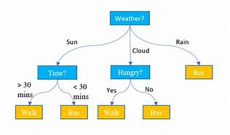
Decision trees

Slide 16
With SCIkit-learn
import pandas
from sklearn import tree
import pydotplus # pip install pydotplus
from sklearn.tree import DecisionTreeClassifier
import matplotlib.pyplot as plt
import matplotlib.image as pltimg
# I had to install graphviz and add it to my path
import os
os.environ["PATH"] += os.pathsep + 'C:/Users/ABeatty/Desktop/Graphviz/bin/'
df = pandas.read_csv("shows.csv")
#print(df)
d = {'UK': 0, 'USA': 1, 'N': 2}
df['Nationality'] = df['Nationality'].map(d)
d = {'YES': 1, 'NO': 0}
df['Go'] = df['Go'].map(d)
features = ['Age', 'Experience', 'Rank', 'Nationality']
X = df[features]
y = df['Go']
dtree = DecisionTreeClassifier()
dtree = dtree.fit(X, y)
data = tree.export_graphviz(dtree, out_file=None, feature_names=features)
graph = pydotplus.graph_from_dot_data(data)
graph.write_png('mydecisiontree.png')
img = pltimg.imread('mydecisiontree.png')
imgplot = plt.imshow(img)
plt.show()

Slide 17
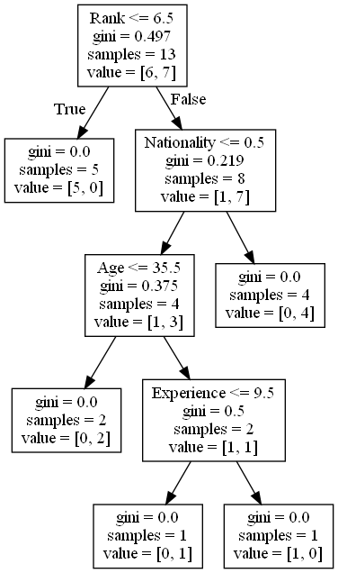

Slide 18
Take a break

